Slide 1

SMART GARBAGE MONITORING SYSTEM
By: Manav Chauhan
University Roll No: 2018919
Mentor: Dr. Sachin Sharma

Slide 2
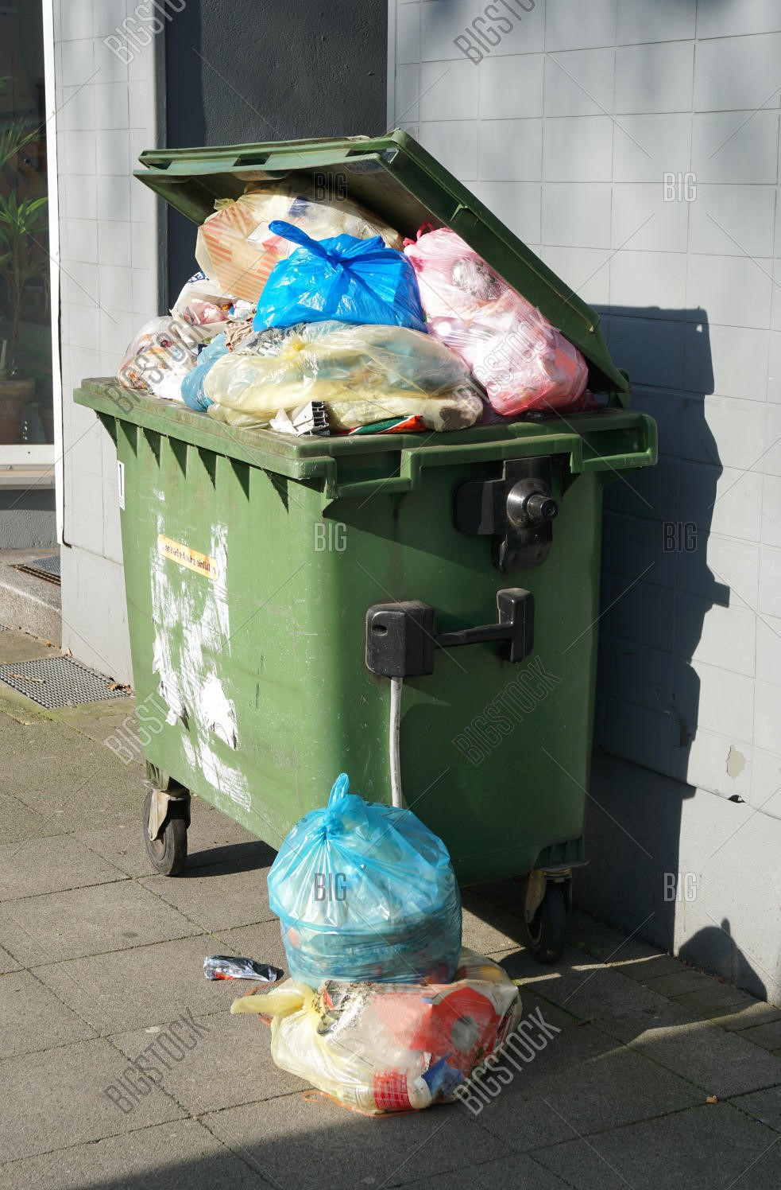
INTRODUCTION
The problem that my project addresses is that of garbage accumulation at various locations in our city. Overflowing of garbage bins has been a problem that leads to foul smell, negatively affects the beauty of the surroundings and acts as a nesting place for pests and rodents.
In this project, development of a system has been done using Internet of Things to solve the problem mentioned.

Slide 3
HOW DOES IT WORK?
Internet of Things is essentially a network of physical devices that is connected through wires or without wires that has the ability to do communication and exchange data with one another.
It aims to solve the issue of human intervention in such situations, where poor management and lack of concern for garbage has become a problem.
Here we are using IoT to monitor the level of garbage in a dust bin which can potentially be expanded to other dust bins in a city to effectively monitor the garbage level in the entire city for timely management.

Slide 4

METHODOLOGY
Hardware: Components used are Ultrasonic sensor, Arduino Uno, connecting wires and a cardboard box that can be used as a dust bin. The proper connections are done on the dustbin.
Writing code for sensor: The hardware is connected to a computer and coding is done using the Arduino IDE to calculate the level of garbage inside the dustbin. Additionally, a threshold value is defined for sending alerts to the concerned authorities.

Slide 5
METHODOLOGY
Creating Web App for displaying alerts: A web app is created which is used to read alerts generated from the smart bin from either a cloud service or read locally and displays an appropriate message.
The web app is interfaced with the data read from the sensor, our system is ready now.

Slide 6

RESULT
As soon as a garbage item enters the smart bin which makes the level of garbage go over the threshold limit, Arduino reads this data and writes it locally on a file. The web app reads data from the file and notifies the user that the dustbin is full.

Slide 7
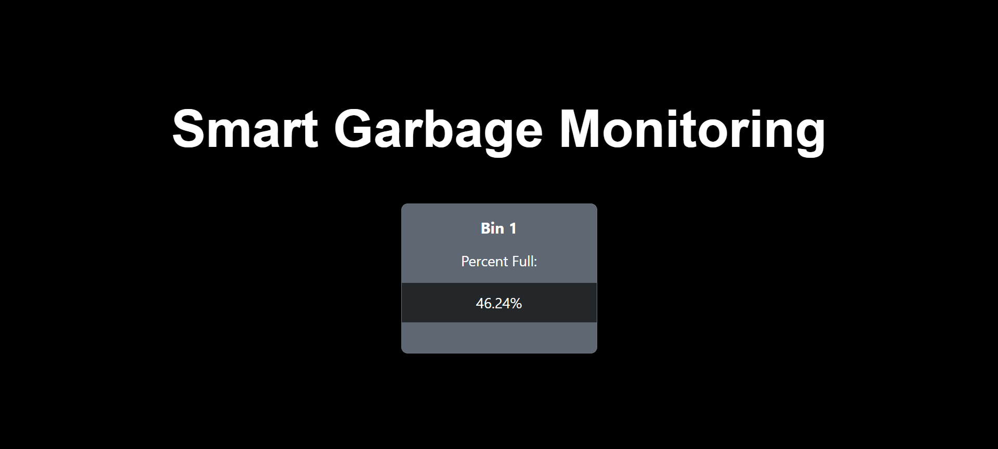
WEBSITE

Slide 8
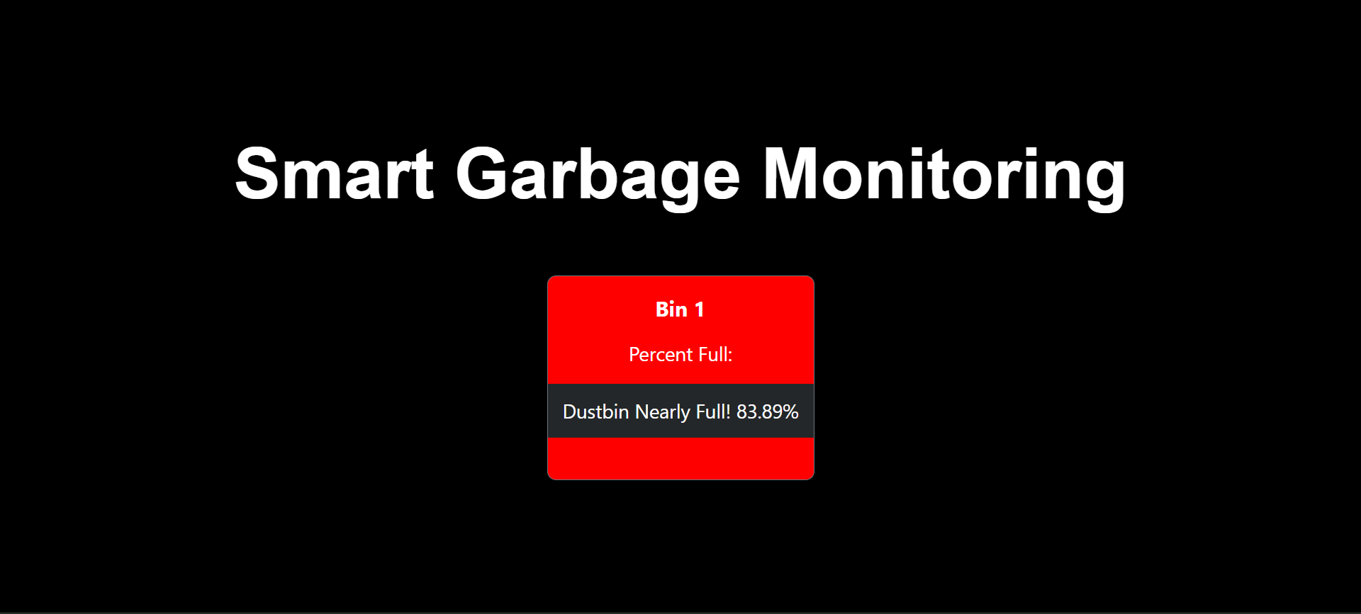
RESULT
The garbage monitoring system can effectively monitor the garbage level and notify the user or concerned authority on bin overflowing.

Slide 9

CONCLUSION AND FUTURE WORK
The main objective of this system is to maintain a healthy and clean environment in our city around us. The smart garbage monitoring system can efficiently handle the problem of waste disposal by continuous monitoring such that no dustbin overflows and concerned authorities are notified to keep our city clean and hygienic.
In the future, many smart bins can be set up which use a GPS module such that the location of each of the bin can be tracked effectively and AI based algorithms can be used to decide the minimum distance path that waste management authorities can use to collect the data from different points in the city.
A camera can be fit inside these smart bins along with a servo motor system which classifies the garbage into biodegradable and non-biodegradable and thus puts the garbage into their respective partitions inside the smart bin.

Slide 10

THANK YOU!
Have a nice day!

